Slide 1
Predict Student Performance
What are the most common features that may affect on students performance ?
Can the model predicted the student performance ?
About: This dataset contains information about student performance in Portuguese in two different secondary schools. The dataset includes student grades, demographic, social and school related features and it was collected by using school reports and questionnaires

Slide 2
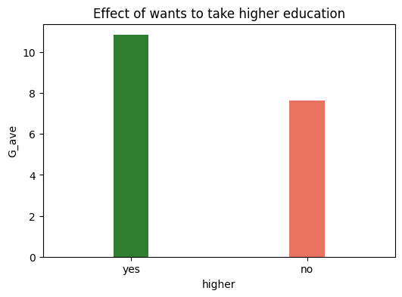
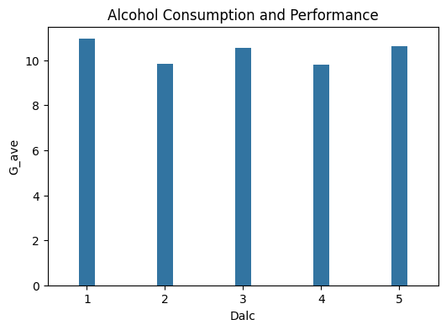
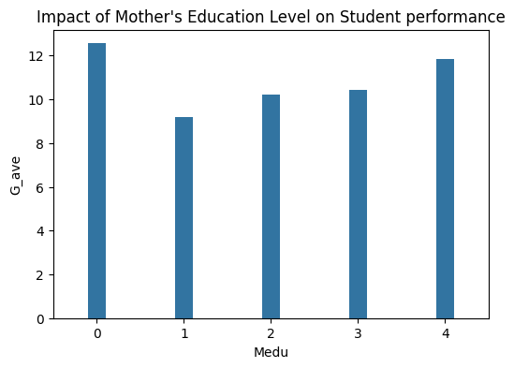
Features that have a Positive Effect on student performance
Students with:
A mother who has a lowest and highest level of education
A strong desire to pursue higher education
More hours dedicated to studying
A mother or father working in health or teaching professions
A home in an urban area
No romantic relationship
Access to the internet

Slide 3
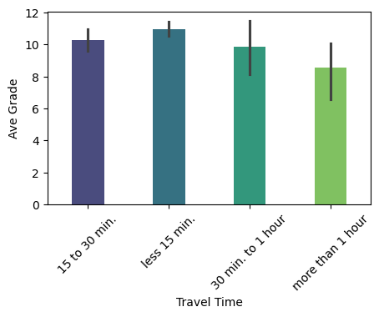
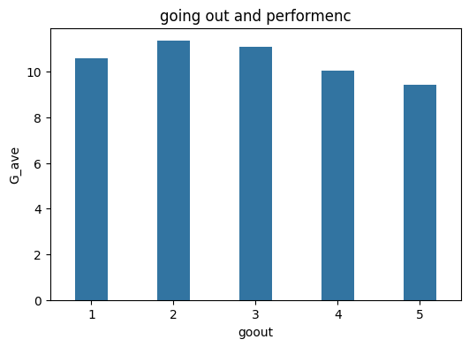
Features that have a Negative Effect on student performance
Students with:
Many class failures
No desire to pursue higher education
Frequent going out with friends
More than one hour of travel from home to school

Slide 4
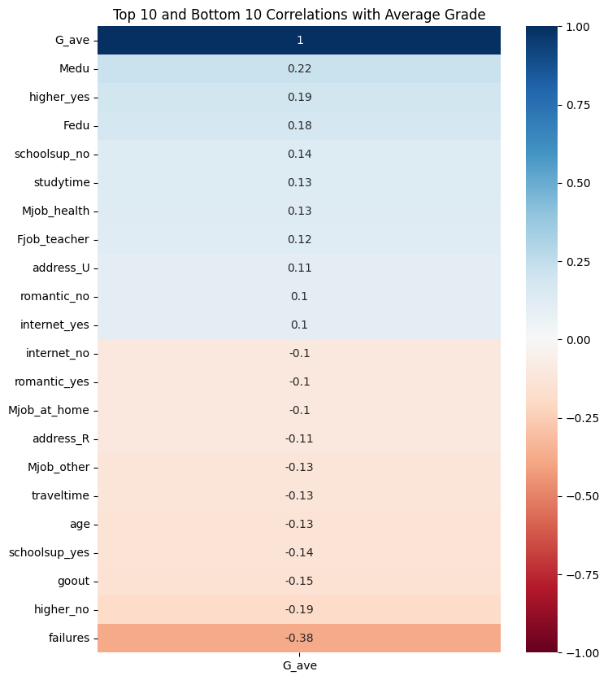
Student with:
Mother education, desire to continue a higher education , Father education and school support has positive impact on student performance
Student with:
Failures, no desire to high education, going out many days a week have a negative impact on performance.
Correlations between student performance and all features

Slide 5
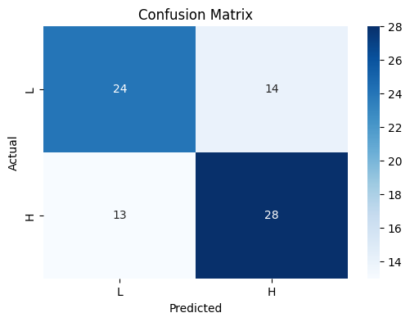
the model was able to predict student performance to a reasonable extent, but there are significant inaccuracies, so it will needed to improve its predictive capability.
Model Performance Metrics
Metric | Value
Accuracy | 0.66
Classification Report
Class | Precision | Recall | F1-Score | Support
H | 0.65 | 0.63 | 0.64 | 38
L | 0.67 | 0.68 | 0.67 | 41
Improving the model may involve:
Tuning the model parameters.
Trying different machine learning algorithms.
Feature engineering and selection.
Addressing class imbalance if it exists.

